Slide 1
A NOVEL DESIGN FRAMEWORK FOR SMART OPERATING ROBOT IN POWER SYSTEM
ANJALI SIJI
CLASS NO:12, S7 BTECH CSE
10 OCTOBER 2018

Slide 2
CONTENTS
INTRODUCTION
ISSUES
DEMANDS
PROPOSED SYSTEM
AI
DEEP LEARNING
INTELLIGENT POWER SYSTEM ANALYSIS SYSTEM
SMART OPERATION TICKET COMPILING SYSTEM
CONCLUSION
REFERENCES

Slide 3
INTRODUCTION
Power system
Control center : monitor and analyze status
Smart Operating Robot

Slide 4
ISSUES
Analysis system in control center not fast and powerful.
Operation tickets compiled manually.

Slide 5
DEMANDS FOR SMART POWER SYSTEM OPERATIONS
Better power system analysis system.
Current power system analysis tool : DSA

Slide 6
DEMANDS FOR SMART POWER SYSTEM OPERATIONS(contd…)
SCADA- readings of the power system are collected.
States are input to the DSA for analysis
Delay to get the final analysis result
Analysis result not in real time.

Slide 7
DEMANDS FOR SMART POWER SYSTEM OPERATIONS(contd…)
The SCADA processes, distributes, and displays the data
Helps operators and other employees analyze the data
Influence important decisions.
Traditional system slower

Slide 8
DEMANDS FOR SMART POWER SYSTEM OPERATIONS(contd…)
Compiling the operation tickets.
Keep the operation ticket error free.
Human errors : tiredness and careless.
Operation tickets compiled by different operators for the same incident is different.
Compilation : experience, reasoning and abstract thinking .

Slide 9
PROPOSED SYSTEM
Framework of smart operating system
AI, neural networks with deep learning
Highly non linear, complex power system

Slide 10
ARTIFICIAL INTELLIGENCE
Simulation of human intelligence
Processes are learning, reasoning and self correcting.
Goals of AI
To create expert systems
To implement human intelligence in machines
+

Slide 11
DEEP LEARNING
Use a cascade of multiple layers
nonlinear processing units
Accurate feature extraction and transformation.
Each successive layer uses the output from the previous layer as input.

Slide 12
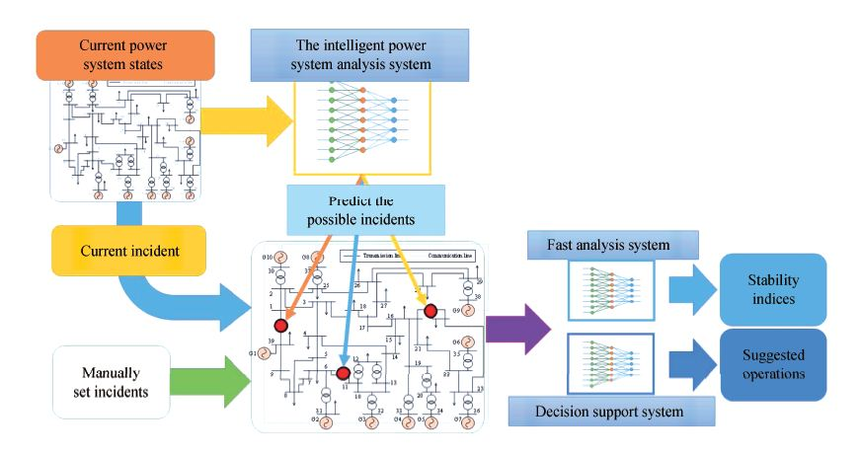
FRAMEWORK OF THE ANALYSIS SYSTEM
Courtesy : https://ieeexplore.ieee.org/document/8283978

Slide 13
INTELLIGENT POWER SYSTEM ANALYSIS SYSTEM
It analyze the state of power systems
provide operation suggestions.
DSA - not in real time.
Ability to fast analyze the power system, predict states of and provide operation suggestions.

Slide 14
INTELLIGENT POWER SYSTEM ANALYSIS SYSTEM(contd…)
System include
Fast analysis system.
Incident prediction and warning system.
Decision support system.

Slide 15
FAST ANALYSIS SYSTEM
Group of neural network.
Inputs are the states of the power system.
Initial power flow.
The equipment status.
Maintenance plan.
Generator status.
Weather forecasting information.
Each neural network outputs different stability indices.

Slide 16
FAST ANALYSIS SYSTEM
Calculations are very fast once the neural network is trained.
Much faster than conventional method.

Slide 17
INCIDENT PREDICTION AND WARNING SYSTEM
Operator may not able to react with incidents.
Predict the power system status.
Prepared before any real incident happens.
Based on the deep learning method.

Slide 18
INCIDENT PREDICTION AND WARNING SYSTEM
Factors causing the incidents
Weather condition, construction, aging
Inputs
Weather forecasting information, the construction schedule, the equipment status
Output
Identify the line or bus have incident

Slide 19
DECISION SUPPORT SYSTEM
Possible operations and actions.
Better and faster decision.
Impacts of the incidents reduced.
Deep neural network
Trained with the historical data of operations and actions

Slide 20
SMART OPERATION TICKET COMPILING SYSTEM
Facility maintenance.
Fault recovery.
Automatic operation ticket generation.
Human errors prevented.
Human in the loop system.
Rule base.

Slide 21
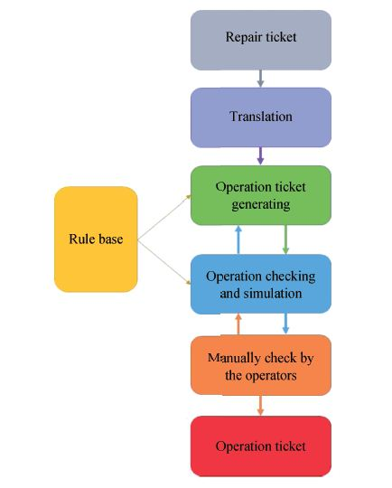
SMART OPERATION TICKET COMPILING SYSTEM
Courtesy : https://ieeexplore.ieee.org/document/8283978

Slide 22
SMART OPERATION TICKET COMPILING SYSTEM
Report repair ticket.
Translated.
Operation ticket generating.

Slide 23
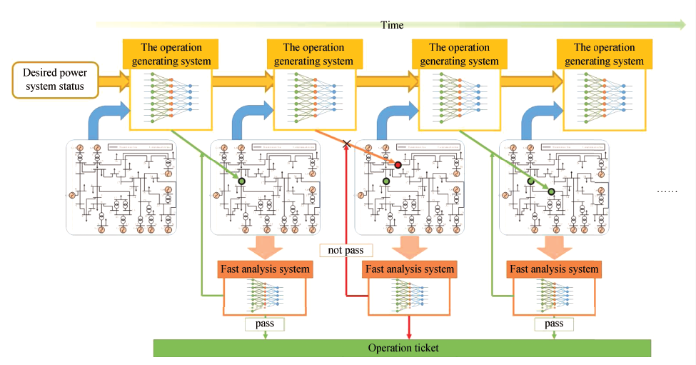
OPERATION TICKET GENERATING SYSTEM
Courtesy : https://ieeexplore.ieee.org/document/8283978

Slide 24
CONCLUSION
Efficient analysis system
Better accuracy
Support of Deep learning
Decreased human intervention

Slide 25
REFERENCES
[1] C. Q. Jiang, H. Zhou, and Q. J. Deng, “A new system of operation ticket for generation and misoperation prevention in smart distribution network,” in Proc. 2011 Int. Conf. Electric Information and Control Engineering, Wuhan, China, 2011, pp. 60−64.
[2] Y. J. Li, Q. Zhang, D. Y. Zheng, P. Y. Xu, and B. Z. Wu, “On operation ticket expert system for a substation using object oriented technique,” in Proc. 27th Chinese Control Conf., Kunming, China, 2008, pp. 2−5.
[3] K. N. Chen, B. M. Zhang, W. C. Wu, and H. B. Sun, “An intelligent checking system for power system operation tickets,” in Proc. 4th Int. Conf. Electric Utility Deregulation and Restructuring and Power Technologies, Weihai, Shandong, China, 2011, pp. 757−762.
[4] Y. LeCun, Y. Bengio, and G. Hinton, “Deep learning,” Nature, vol. 521, no. 7553, pp. 436−444, May 2015.
[5] F. Y. Wang, “Toward a revolution in transportation operations: AI for complex systems,” IEEE Intell. Syst., vol. 23, no. 6, pp. 8−13, Nov.−Dec. 2008.

Slide 26
REFERENCES
[6] F. Y. Wang, “Parallel control and management for intelligent transportation system: concepts, architectures and application.” IEEE Transactions on Intelligent Transportation Systems, vol.11, no.3, pp.1−10, 2010.
[7] D. Silver, A. Huang, C. J. Maddison, A. Guez, L. Sifre, G. Van Den Driessche, J. Schrittwieser, I. Antonoglou, V. Panneershelvam, M. Lanctot, S. Dieleman, D. Grewe, J. Nham, N. Kalchbrenner, I. Sutskever, T. Lillicrap, M. Leach, K. Kavukcuoglu, T. Graepel, and D. Hassabis, “Mastering the game of go with deep neural networks and tree search,” Nature, vol. 529, no. 7587, pp. 484−489, Jan. 2016.
[8] Y. X. Wang, M. Q. Liu, and Z. J. Bao, “Deep learning neural network for power system fault diagnosis,” in Proc. 35th Chinese Control Conf., Chengdu, China, 2016, pp. 6678−6683.
[9] T. S. Bi, Y. X. Ni, C. M. Shen, and F. F. Wu, “A novel ann fault diagnosis system for power systems using dual GA loops in ANN training,” in Proc. Power Engineering Society Summer Meeting, Seattle, WA, USA, 2000, pp. 425−430.
[10] Y. L. Zhu, L. M. Huo, and J. L. Lu, “Bayesian networks-based approach for power systems fault diagnosis,” IEEE Trans. Power Deliv., vol. 21, no. 2, pp. 634−639, Apr. 2006.

Slide 27
THANK YOU

